Slide 1
Weight-Neutral Patient Advocate Program Module 3 Special Circumstances: GLP-1s and BMI-Based Procedure Denials
Ragen Chastain Ragen@WeightAndHealthcare.com

Slide 2
Agenda
GLP-1 agonists
BMI-Based Healthcare Denials

Slide 3
GLP-1 Agonists (Weight Loss Drugs)

Slide 4
A Brief History of Weight-loss Drugs

Slide 5
History Repeating
Skewed risk/benefit analysis
Marketing/Selling/Prescribing based on short-term research
Creating long-term harm
That was predictable from initial research
Recalls and market withdrawals

Slide 6
Fen-Phen Fenfluramine and Phentermine
Appetite suppressant plus amphetamines
1992 – introduced to the market
1994 – Company aware of 41 cases of valvular heart disease and pulmonary hypertension
Reported only 4 to the FDA
1996 – doctors wrote 18 million prescriptions
1997 – studies showed about a third of patients had serious side effects including heart disease, valvular heart disease, primary pulmonary hypertension), and cardiac fibrosis.
1997 – Recalled
2000 - $4.75 Billion settlement

Slide 7
Case Study: Belviq
2009
The FDA does not approve diet drug Belviq because of potentially life-threatening side effects
2012
The FDA approves Belviq despite potentially life-threatening side effects
Belviq pulled from the market due to life-threatening side effects
2020

Slide 8
Meet the New Drugs
Semaglutide
Novo Nordisk
GLP-1 agonist
Ozempic = Type 2 Diabetes, weekly injection
Rebylsus = Type 2 Diabetes, daily pill
Wegovy = Weight Loss, weekly injection
Tirzepatide
Eli Lilly
GLP-1, GIP co-agonist
Mounjaro = Type 2 Diabetes, weekly injection
Zepbound = Weight Loss Application
No pill form

Slide 9
What is a GLP-1 Receptor Agonist
Type 2 Diabetes Medication
Mimics glucagon-like peptide-1, a hormone produced by the body
Triggers the pancreas to release insulin
Blocks glucagon secretion
Slows gut motility
Increases satiety

Slide 10
What is a GIP Receptor Agonist
Type 2 Diabetes Medication
Mimics Gastric Inhibitory Polypeptide (GIP) hormone
Encourages the production of insulin
Increases sensitivity to insulin itself
Reduces the production of stomach acid

Slide 11
Successful Type 2 Diabetes Drugs
Act only when blood sugar is high
Reduces hypoglycemic episodes
Work well for some people who are contraindicated for other drugs
Work well for some people who have not achieved glycemic management on other drugs
Not typically a front-line med
Were found to have a side effect of weight loss

Slide 12
Difference between T2D and Weight Loss Applications
Dosing and titration
T2D – dosed for lowest amount necessary to get desired glycemic management and MINIMIZE side effect
Weight loss application
Dosed and titrated only to MAXIMIZE side effects
Maximizes all dose dependent side effects

Slide 13
Dosing Differences
Semaglutide
Ozempic maximum dose = 2mg (up from 1mg 2 years ago)
Wegovy recommended dose - 2.4mg, allowed to reduce only to 1.7mg
Tirzepatide
Same dose options as Mounjaro (2.5mg, 5mg, 7.5mg, 10mg, 12.5mg, 15mg)
Early weight loss studies looked at 5mg, 10mg, and 15mg
Later studies dropped 5mg and those would couldn’t tolerate at least 10mg were dropped from the study

Slide 14
How they (may) create weight loss
Two primary mechanisms:
Slow gut motility/food digestion
Create a sense of fullness
Disrupt hunger signals from the brain
Where do they work?
Original assumption – in the gut (short duration)
Current belief – in the brain (how and duration unknown)

Slide 15
Side effects
Common side effects
Nausea, diarrhea, vomiting, constipation, stomach (abdomen) pain, headache, tiredness (fatigue), upset stomach, dizziness, feeling bloated, belching, gas, stomach flu, and heartburn
Serious Side Effects
Risk of thyroid c-cell tumors (box warning)
Acute pancreatitis, Acute gallbladder disease, Hypoglycemia, Acute kidney injury, Hypersensitivity, Diabetic retinopathy complications, Heart rate increase, Suicidal ideation and behaviors, Ileus
Additional issues
Interferes with medication absorption
Possible fetal harm (2 month half-life)

Slide 16
The Research

Slide 17
Once-Weekly Semaglutide in Adults with Overw*ight or Ob*sity
68 weeks, 1961 assigned 2:1 treatment to placebo
Demographics
Average age: 46
73.1% cis female
74.5% white
17.1% did not complete treatment
10.4% of the 82.9 completers were not at the 2.4mg dose

Slide 18
Once-Weekly Semaglutide in Adults with Overw*ight or Ob*sity

Slide 19
Once-Weekly Semaglutide in Adults with Overw*ight or Ob*sity
16.5% lost less than 5% body weight
33.9% failed to lose 10%
52.1% failed to lose 15%
69.8 failed to lose 20%

Slide 20
Two-year effects of semaglutide in adults with overw*ight or ob*sity: the STEP 5 trial
104 weeks, 304 participants (152 each semaglutide and placebo)
Demographics
Average age: 47.3
77.6% cis female
92.8% white
86.8% completed treatment
90.9 on 2.4mg
22.9% did not lose 5% or more of body weight
“Sustained” – regaining slowly

Slide 21
Semaglutide, 104 week study

Slide 22
Adverse Effects
Per 100 patient-years
532.3 adverse events, 6 serious adverse events patient-years, 4 serious events that lead to discontinuation
Every 25 years: 133 adverse events, 1.5 serious adverse events, .9 events that cause discontinuation

Slide 23
Novo’s Conclusion
“When interpreted together with the findings of the STEP 4 withdrawal trial and STEP 1off-treatment extension study, which both showed weight regain after semaglutide discontinuation (after 20 weeks’ treatment in STEP 4 and 68 weeks’ treatment in STEP 1) these results support the benefit of continued semaglutide treatment for sustained weight loss.”
Ignores weight trending up
False dichotomy

Slide 24
Novo Nordisk – SELECT Cardiovascular Trial
Press release instead of peer-reviewed research
Semaglutide 2.4 mg reduces the risk of major adverse cardiovascular events by 20% in adults with overw*ight or ob*sity in the SELECT trial
20%
20% is relative risk reduction, not absolute risk reduction
Adults
Over 45
With CVD and without T2D
With “Overweight” or “Obesity”
Actual definition – BMI of 25+
Their study – BMI of 27+
Making up your own criteria for terms that have an established meaning is not a research methods best practice
Novo Nordisk’s stock went up 17% in one day

Slide 25
The Actual SELECT Trial
1.5% reduction
In combination of three events, not individual events
Statistically significant for:
Cis white men, with an average age of 61.6
Not statistically significant for:
Woman, Black people, Hispanic people, those at the highest end of the weight spectrum

Slide 26
Tirzepatide
Co-GLP-1 GIP receptor agonist (like Wegovy)
72 week trial
Average age, 47.1
70% cis women
80.6% white
>80% of participants had more than 1 adverse event
Black Box Warning: thyroid C-cell tumors

Slide 27
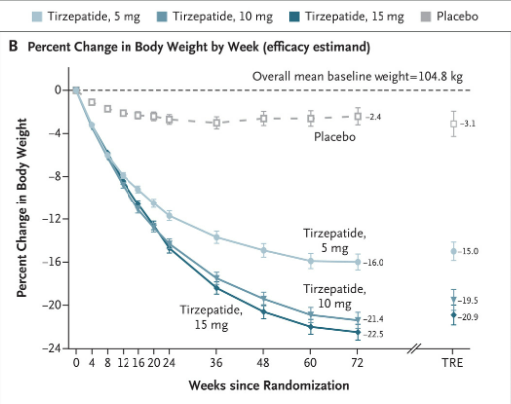

Slide 28
Tirzepatide long-term study
36 week treatment following by 52 weeks with a treat and no-treat group
783 participants were enrolled
a little over 14% didn’t even make it 9 months on the drug, and that’s including the fact that the drug was started at a minimal 2.5mg dose and then increased by 2.5 mg every 4 weeks until a maximum tolerated dose of 10 or 15 mg was achieved
Those who went off the drug regained weight rapidly
10.5% of the group who were still taking the drug during the one-year follow-up had already gained back more than 20% of the weight they lost
“maintaining” weight loss was defined as regaining the lost weight slowly enough that by 52 weeks these participants hadn’t regained 20% of the weight that they lost in the first 32 weeks

Slide 29
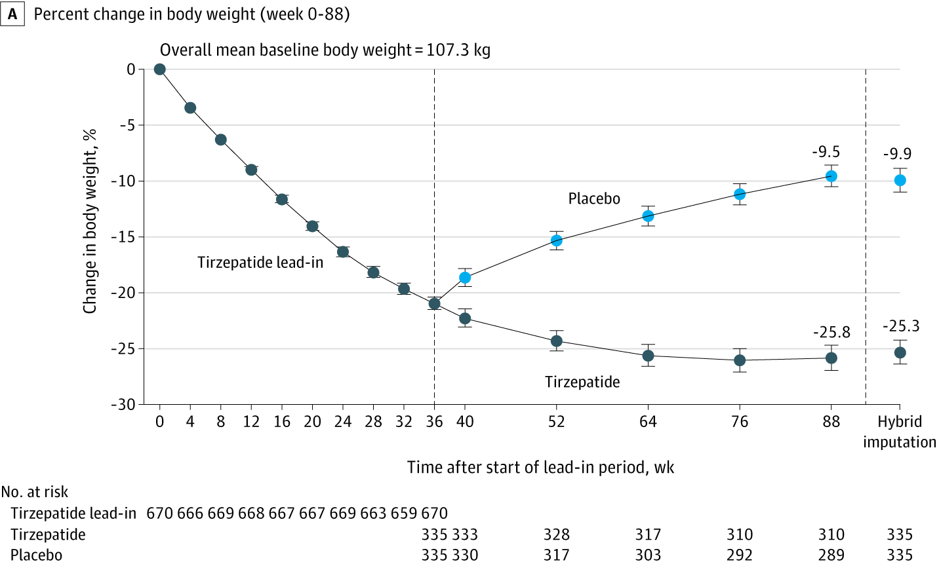
Tirzepatide 88 week study

Slide 30
What’s Not There
Lower doses
Weight neutral comparator group

Slide 31
Supporting the Patient

Slide 32
Supporting patients around GLP-1 Agonist Drugs
Explain the options
Explain the research (within your scope of practice)
Explain the right of informed consent/refusal around these drugs

Slide 33
Advocating for the Patient

Slide 34
Advocating for patients around GLP-1 Agonist Drugs
Assist with eliciting ethical informed consent from providers
Push beyond answers like “all drugs have side effects”
Ask about what information isn’t there
Alternative options
Weight-neutral options
Alternative medications

Slide 35
BMI-Based Denials of Care

Slide 36
Basics
Occur when people are refused medical procedures unless or until they meet the BMI or weight requirement
Justifications
Complication rates and outcomes
Based on and perpetuate weight stigma
Denied wanted surgery and then referred to weight loss surgery
Offered for emergencies but not planned
Surgeon stats
Resources

Slide 37
Grounding Principle to Patients
BMI-based denials hold healthcare hostage
for a weight loss ransom
This is becoming your problem,
but it is not your fault
You deserve ethical, evidence-based care
in the body you have
Here are your choices…

Slide 38
Joint Replacement
Inacia et. al, The risk of surgical site infection and re-admission…
“Study of Kaiser members shows worse outcomes with intentional weight loss before surgery”
Smith et. al., Does bariatric surgery prior to total hip or knee replacement reduce post-operative complications
“Weight loss surgery does not improve surgical complication rates”
Cao et. al, ob*sity does not increase blood loss or incidence of immediate postoperative complications …
“Ob*sity does not increase blood loss or incidence of immediate postoperative complications”
Wenjun et.al., Functional Gain and Pain Relief After Total Joint Replacement According to ob*sity Status
"Our data shows it's not necessary to ask patients to lose weight prior to surgery…severe m*rbidly ob*se patients can benefit almost equally as normal weight patients in pain relief and gains in physical function.”

Slide 39
Lumbar Spine
Willems, et al, The impact of being overweight or obese on 12 month clinical recovery in patients following lumbar microdiscectomy for radiculopathy “no significant associations between the BMI categories and poor recovery from back pain, leg pain, and disability.”
Singh et al. Less invasive posterior lumbar interbody fusion and obesity: clinical outcomes and return to work “We conclude that a high BMI should not be a contraindication to surgery in patients with degenerative low back pain.”
Lingutla et al, Outcome of lumbar spinal fusion surgery in obese patients “Pain and functional outcome are similar to non-ob*se patients. Based on these results, ob*sity is not a contraindication to lumbar spinal fusion.”
Jackson et al., The Effects of Obesity on Spine Surgery: A Systematic Review of the LiteraturE “given the equivalent or greater treatment effect of surgery, this comorbidity should not prohibit ob*se patients from undergoing operative intervention”
Abbasi et al., Effect of Body Mass Index on Perioperative Outcomes in Minimally Invasive Oblique Lateral Lumbar Interbody Fusion versus Open Fusions: A Multivariant Analysis. “In OLLIF [oblique lateral lumbar interbody fusion ], BMI does not affect perioperative outcomes.
Cofano et al. Obesity and Spine Surgery: A Qualitative Review About Outcomes and Complications. Is It Time for New Perspectives on Future Researches? “Evidence suggest that ob*se patients could benefit from spine surgery and outcomes be satisfactory.”

Slide 40
Gender Affirmation Procedures
Brownstone et al, Body Mass Index Requirements for Gender-Affirming Surgeries Are Not Empirically Based
This study looked at the most common gender-affirming procedures
“literature suggests that the most commonly pursued GAS procedures can be safely performed on ob*se patients”
“Research and clinical practice are hindered by continued reliance on BMI as a requirement for GAS [Gender Affirmation Surgery] candidacy.”

Slide 41
Supporting/Advocating for the Patient

Slide 42
Step 1 – Gather Information

Slide 43
How to get information
In writing if possible
Patient Portal, emails/messages with practitioner
Get permission to record
Take notes for the client

Slide 44
Where is the Denial Coming From?
Surgeon
Anesthesiologist
Facility
Insurance

Slide 45
Reason for the Denial
Anesthesia risk?
Risk of perioperative complications?
Concerns about recovery time/post-op complications?
Concerns about outcomes not being as good as a thinner person’s outcomes?

Slide 46
Options for Handling Denials

Slide 47
Find New Circumstances
Different surgeon
bit.ly/MaryLambertList
Different Anesthesiologist
From bariatrics department?
Different Facility
Different Insurance

Slide 48
Fight the Denial

Slide 49
Gather More Information
Start with the information you gathered about the reason
Learn the process to challenge the decision
Elicit support from within the healthcare system
Surgeon, PCP
Consider an attorney

Slide 50
If the denial is about risks/complications
Possible impact of stats
You can’t have surgery – we recommend surgery
Ask for research
Get support analyzing
Ask for/offer an informed consent option

Slide 51
It the denial is because outcomes won’t be as good as thin people’s
Using the harms of weight stigma to justify additional weight stigma
The belief that higher-weight people won’t have the same outcomes as thinner people doesn’t justify a lack of care for higher-weight patients
HWPs deserve reduced pain, increased mobility, gender affirmation etc.
Ask for/offer informed consent

Slide 52
If the argument is that weight created the issue/”They’ll go back to old habits”
People of all sizes have these issues
Athletes routinely get these surgeries
Recreational soccer

Slide 53
If referred to weight loss surgery
Significant risks, few prognostics and almost no outcome data past ten years
VS
Better data and lower risk of re-surgery than weight loss surgery

Slide 54
If referred to weight loss drugs
Significant side effects
Can impact surgery
GLP-1 agonists and anesthesia issues
Weight is regained when drugs are ceased
Dangers of weight cycling
No research showing improved surgical outcomes
Significant expense
Delayed care

Slide 55
Trying to Reach the BMI Requirement
Unless it’s just a few pounds, the chances of success are not very good.
Most likely long-term outcome will be weight regain, which means that they’ll have to time the procedure before they regain to a point where they no longer meet the BMI requirement
Weight cycling which is, by far, the most common outcome of weight loss attempts is independently linked to harm to health including higher mortality

Slide 56
Trying to Reach the BMI Requirement
The process of weight loss, especially if someone is trying to achieve rapid weight loss, could negatively impact surgical outcomes
There is always the possibility that the weight loss attempt can create/exacerbate an unhealthy relationship with food, body, and/or movement up to and including an eating disorder
If someone turns to weight loss drugs or weight loss surgery then the risks/side effects, including risks to life itself, rise significantly

