Slide 1
Weight-Neutral Patient Advocate Program Module 2 The Weight Centric and Weight Neutral Paradigms
Ragen Chastain Ragen@WeightAndHealthcare.com

Slide 2
Agenda
The Weight Centric Paradigm
The Weight Neutral Paradigm
Supporting the Patient
Advocating for the Patient

Slide 3
The Weight Centric Paradigm

Slide 4
Basic Premise
Existing in a higher-weight body is a disease state
Regardless of actual health status
Weight loss is the “cure”

Slide 5
Definition of Intentional Weight Loss
Intentional Weight Loss
Any attempt to purposefully decrease body size based on the idea that a thinner body is better/healthier than a fatter body
IWL Includes
Using food and/or movement and may be called: dieting, lifestyle change, health plan, nutrition plan etc.

Slide 6
In Summary - The Truth about Weight Loss
“There isn’t even one peer-reviewed controlled clinical study of any intentional weight-loss diet that proves that people can be successful at long-term significant weight loss. No commercial program, clinical program, or research model has been able to demonstrate significant long-term weight loss for more than a small fraction of the participants. Given the potential dangers of weight cycling and repeated failure, it is unscientific and unethical to support the continued use of dieting as an intervention for obesity.”
--Wayne Miller, George Washington University

Slide 7
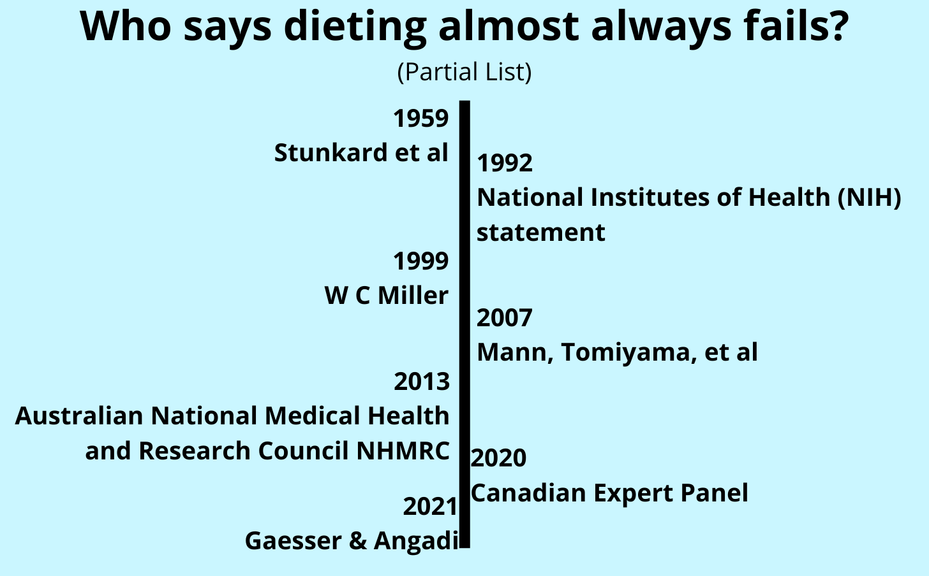

Slide 8
What The Research Actually Finds
Almost everyone loses weight short-term (1 year)
About 95% regain weight long-term (2-5 years)
Up to 66% of people regain more weight than they lost

Slide 9
Case Study – Wharton, Kuk et. al.
Headline: Psychiatric Drugs Aren’t Barriers to Success in Weight-Loss Program
US Pharmacist “The Pharmacist’s Resource for Clinical Excellence”
Study: Effectiveness of a Community-Based Weight Management Program for Patients Taking Antidepressants and/or Antipsychotics
Stated Conclusion “Results of this study suggest that those who participate in a weight management program can lose significant amounts of weight regardless of psychiatric medication use.”
Actual results
2.9% body weight loss on average
“Indeed, while the overall amount of weight loss achieved in this sample was modest (3.4 kg or 2.9%), this is consistent with 3% achieved on average from long-term lifestyle interventions”

Slide 10
The 5-10% weight loss myth
The Claim: 5-10% weight loss creates clinically meaningful health benefits
How do we define significant?
The great falling number of “clinically significant” weight loss
Metropolitan Life Insurance height/weight tables
20%
5-10%
3-5%
How much weight would a 300lb person need to lose to get “health benefits”
1942: At least 150 pounds
1959: 57.6 pounds
1995-2023: 14.4 pounds
Recent guidelines: 8.6 pounds

Slide 11
The 5-10% Weight Loss Myth Tomiyama, Ahlstrom, and Mann, 2013
“In correlational analysis we uncovered no clear relationship between weight loss and health outcomes related to hypertension, diabetes or cholesterol, calling into question whether weight change per se had any causal role in the few effects of the diets. Increased exercise, healthier eating, engagement with the health care system, and social support may have played a role instead.”
Behavior Changes
Health Changes
Weight Changes

Slide 12
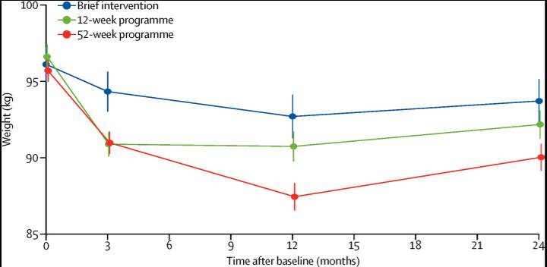
How the research misleads us
Short-term focus
Ignores drop-out rates
Poor design/inappropriate conclusions
Example: Weight Watchers/WW
“Although it costs more, modelling suggests that the 52-week programme is cost-effective in the longer term”

Slide 13
Control Error 2: Effects of Weight Cycling
The risks associated with weight cycling are very much the same as those associated with obesity
Gaesser and Angadi, Obesity treatment: Weight loss versus increasing fitness and physical activity for reducing health risks
Attempts to lose weight typically result in weight cycling…
weight cycling results in increased inflammation, which in turn is known to increase risk for many obesity-associated diseases.
weight cycling is associated with T2D, Hypertension, CVD, and increased mortality risk.
“Weight cycling can account for all of the excess mortality associated with obesity in both the Framingham Heart Study and the National Health and Nutrition Examination Survey (NHANES).”
-Bacon and Aprhramor, Weight Science: Evaluating the Evidence for a Paradigm Shift

Slide 14
Basic Premise Error Part 1
If higher-weight patients experience a health issue more often than thinner patients, then their body size is to blame
Correlation/Causation
Testing rate
Confounding variables
The war on baldness

Slide 15
Case Study– H1N1
During the 2009 H1N1 outbreak, there was a strong correlation between fatness and negative outcomes
After the outbreak a study was conducted. It found that thin people were given earlier antiviral treatment than fat people and that:
“After adjustment for early antiviral treatment, relationship between obesity and poor outcomes disappeared.”
Sun et. al. Weight and prognosis for influenza A(H1N1)pdm09 infection during the pandemic period between 2009 and 2011: a systematic review of observational studies with meta-analysis

Slide 16
The Basic Premise Error Part 2
If higher-weight patients experience a health condition more often, or if a healthcare intervention is less effective for them, the solution is to make them into thin(ner) patients
People of the same weight have different health statuses and vice versa
Weight changes without health changes/health changes without weight changes
Success rate of intentional weight loss interventions
Patients need help now – not at some indeterminate, hypothetical time in the future

Slide 17
Weight Science Research and a Lack of Control

Slide 18
Impacts of Weight Stigma/Bias in Practitioner/Patient Relationship
Patient Disengagement
Lack of early detection/screenings
Internalizing weight bias
Mistrust of other practitioner recommendations
Practitioner weight distraction
See the patient as a pathology
Missed diagnoses and recommendations
Weight loss prescriptions and delayed care
Practicing stereotypes instead of medicine/healthcare

Slide 19
Lack of Access To Ethical, Evidence-Based Health Care
Control Error 3 – Healthcare Access
Research
Accommodation
chairs, tools, durable medical equipment
Training
Practitioner Bias – Implicit and Explicit
Two underlying tenets
It’s worth risking fat people’s lives and quality of life in attempts to make them thin
It’s acceptable to insist that fat people become thin before they can access ethical, evidence-based medicine

Slide 20
Case Study – Herriot et. al
Dietetic literature on weight management fails to meet the standards of evidence-based medicine
Herriot et. al: A qualitative investigation of individuals' experiences and expectations before and after completing a trial of commercial weight loss programs.
Conclusion: “all diets in 'Diet Trials' were ultimately successful in achieving weight loss in those who complied” (p 78)
Truth: 64% of subjects had withdrawn by week 8; some people gained weight; weight rebound was common
Aphramor, Validity of claims made in weight management research: a narrative review of dietetic articles

Slide 21
The Cycle of Harm to Higher-Weight People in Healthcare
Blame
higher-weight people’s bodies for the negative outcomes that result
Use negative outcomes to justify additional weight stigma, weight cycling, and care inequalities
Create and perpetuate weight stigma, weight cycling, and care inequalities

Slide 22
The Weight-Neutral Paradigm

Slide 23
Basic Premise
Instead of focusing on manipulating the weight of higher-weight patients, focus on supporting their health at their current size
Research
Tools and Equipment
Practitioner Training - compassion, to practice, to advocacy
Best Practices
Informed consent

Slide 24
25714 adult cis-men
Source: Wei et al. “Relationship Between Low Cardiorespiratory Fitness and Mortality in Normal-Weight, Overweight, and Obese Men.” JAMA. 1999;282: 1547-1553.)

Slide 25
obese
Health Hazard
Ratio
overweight
normal
Number of Healthy Habits
5 or more servings of fruits and vegetables
Exercise more than 12 times per month
Alcohol up to 1 drink/day for cis-women and up to 2 drinks/day for cis-men
not smoking
Matheson et. al.
Healthy lifestyle habits and mortality in overweight and obese individuals.
11,761 cis men and women

Slide 26
Gaesser and Angadi
Analyzed 225 studies, systematic reviews, and meta-analyses
The mortality risk associated with obesity is largely attenuated or eliminated by moderate-to-high levels of cardiorespiratory fitness (CRF) or physical activity (PA)
Most cardiometabolic risk markers associated with obesity can be improved with exercise training independent of weight loss and by a magnitude similar to that observed with weight-loss programs
Weight loss, even if intentional, is not consistently associated with lower mortality risk

Slide 27
Gaesser and Angadi - 2
Increases in CRF or PA are consistently associated with greater reductions in mortality risk than is intentional weight loss
Weight cycling is associated with numerous adverse health outcomes including increased mortality.
Adherence to PA may improve if health care professionals emphasize to their patients the myriad benefits of PA and CRF in the absence of weight loss.

Slide 28
RCT: Weight-Neutral vs Weight loss
Weight-neutral intervention vs Behavior-based weight loss intervention
6-month RCT, 2 years follow up
Attrition at 6 months
Diet group: 41%
Weight-Neutral group: 8%
Follow-up (50% of both groups returned for 2-year evaluation)
Weight-Neutral: maintained weight, improved in all outcome variables, and sustained improvements
Diet group: Weight was regained and little improvement was sustained
Bacon, L., Stern, J. S., Van Loan, M. D., & Keim, N. L. (2005). Size acceptance and intuitive eating improve health for obese, female chronic dieters. Journal of the American Dietetic Association, 105(6), 929–936. https://doi.org/10.1016/j.jada.2005.03.011

Slide 29
Supporting the Patient

Slide 30
Offering information about each paradigm
Provide research and explanation as asked
Within your scope of service
Assist with setting boundaries for weight-neutral care
No medically unnecessary weigh-in
No weight loss or diet talk
Don’t blame things on weight

Slide 31
Explaining Informed Consent and Refusal
Patient has the right to refuse weight-centric care
Any weigh-in that is not medically necessary
Weight loss recommendations
Patient has the right to informed consent
If patient chooses to ask about weight loss recommendation
Fully list of possible side effects/adverse events
“All drugs have side effects” or “it’s well tolerated” do not quality

Slide 32
The Weigh In
Why refuse weigh-in?
Trigger for disordered eating/eating disorder
Trigger for practitioner bias
Trigger for anti-fat insurance treatment

Slide 33
Scripting to decline weigh-in
No Thank You
Insurance Requirement?
If they ask to guess your weight
If you have to weigh in

Slide 34
Scripting to decline weight-loss interventions
What would you offer a thin person with this presentation
As I mentioned, I would like weight-neutral care, what are the options besides attempting weight loss
I’m exercising my right to informed refusal of weight loss. Please move on to other options

Slide 35
Scripting to ask for a weight-neutral provider
“I’m looking for a provider who is willing to provide weight-neutral care. That means treating me without diets or weight loss advice of any kind, is there a doctor in this office who can do that?”

Slide 36
Advocating for the Patient

Slide 37
Assisting with finding a weight-neutral provider
Research possible HCPs (with insurance)
Call ahead
“I am a certified medical advocate working with a patient who needs a [provider] who is willing to provide weight-neutral care. That means treating them without diets or weight loss advice of any kind, is there a [provider] in this office who can do that?”
Remind at check-in

Slide 38
Assisting with Informed Consent/Refusal of Weigh-In or Weight-Neutral Interventions
Support the patient in asking/Ask for the patient if they’ve requested that
Weigh-in
Do you want to decline the weigh-in?
The patient has provided informed refusal of weigh-in
Weight-focused care
“Does what the [provider] is saying fit with the boundaries you set about weight-neutral care?
Is this [weight loss/weight]-focused information helpful to you?

Slide 39
Assisting with asking for weight-neutral interventions
Support the patient in asking
Would you like to hear weight-neutral options?
Ask for the patient (if they’ve requested that)
Just as a reminder, The patient has asked for weight-neutral options, could you provide those?
What would you recommend for a thin patient with the same presentation.

